Slide 1
Data Communication & Computer Networks
Course Instructor:
Mr. Fakhar Ul Islam

Slide 2
Course Intro
Welcome to CS/CSC-2202!
Course web page, including syllabus, lectures notes, assignments, labs, schedule
Grading Policy
Marks Head | Total Frequency | Total Exempted | Marks/Frequency | Total Marks/ Head
Quiz | 4 | 0 | 3.5 | 14
Assignment | 4 | 0 | 4 | 16
Mid Paper | 1 | 0 | 30 | 30
Final Paper | 1 | 0 | 40 | 40
 |  |  | Total Marks | 100

Slide 3
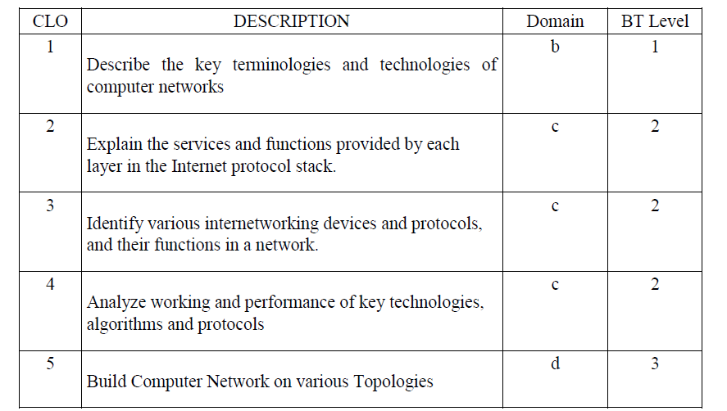
COURSE LEARNING OUTCOMES (CLOs):

Slide 4
Today’s Lecture
  What is the Internet?
  Network edge
    end systems, access networks, links

Slide 5



















What’s the Internet: “nuts and bolts” view
PC
millions of connected computing devices:
  hosts = end systems
  running network apps
mobile network
server
wireless
laptop
global ISP
smartphone
home
network
communication links
  fiber, copper, radio, satellite
  transmission rate: bandwidth
regional ISP
wireless
links
wired
links
Packet switches: forward packets (chunks of data)
  routers and switches
router
institutional
network

Slide 6
What’s the Internet: “nuts and bolts” view
Internet: “network of networks”
  Interconnected ISPs
protocols control sending, receiving of msgs
  e.g., TCP, IP, HTTP, Skype, 802.11
Internet standards
  RFC: Request for comments
  IETF: Internet Engineering Task Force
mobile network
global ISP
home
network
regional ISP
institutional
network

Slide 7
What’s the Internet: a service view
mobile network
Infrastructure that provides services to applications:
  Web, VoIP, email, games, e-commerce, social nets, …
provides programming interface to apps
  hooks that allow sending and receiving app programs to “connect” to Internet
  provides service options
global ISP
home
network
regional ISP
institutional
network

Slide 8
What’s a protocol?
human protocols:
“what’s the time?”
“I have a question”
introductions
… specific msgs sent
… specific actions taken when msgs received, or other events
network protocols:
machines rather than humans
all communication activity in Internet governed by protocols
protocols define format, order of msgs sent and received among network entities, and actions taken on msg transmission, receipt

Slide 9



What’s a protocol?
a human protocol and a computer network protocol:
Hi
TCP connection
request
Hi
TCP connection
response
Got the
time?
Get http://www.google.com
2:00
response
time

Slide 10
Roadmap
  What is the Internet?
  Network edge
    end systems, access networks, links

Slide 11


A closer look at network structure:
network edge:
  hosts: clients and servers
  servers often in data centers
mobile network
global ISP
access networks, physical media: wired, wireless communication links
home
network
regional ISP
network core:
  interconnected routers
  network of networks
institutional
network

Slide 12

Access networks and physical media
Q: How to connect end systems to edge router?
residential access nets
institutional access networks (school, company)
mobile access networks
keep in mind:
bandwidth (bits per second) of access network?
shared or dedicated?

Slide 13

Access net: digital subscriber line (DSL)
central office
telephone
network
DSL
modem
splitter
DSLAM
ISP
voice, data transmitted
at different frequencies over
dedicated line to central office
DSL access
multiplexer
  use existing telephone line to central office DSLAM
    data over DSL phone line goes to Internet
    voice over DSL phone line goes to telephone net
  < 2.5 Mbps upstream transmission rate (typically < 1 Mbps)
  < 24 Mbps downstream transmission rate (typically < 10 Mbps)
Notes:
*DSLAM: A digital subscriber line access multiplexer is a network device, often located in telephone exchanges, that connects multiple customer digital subscriber line interfaces to a high-speed digital communications channel using multiplexing techniques.

Slide 14
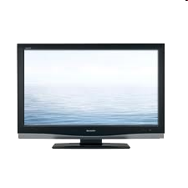


Access net: cable network
cable headend
…
cable
modem
splitter
C
O
N
T
R
O
L
V
I
D
E
O
V
I
D
E
O
V
I
D
E
O
V
I
D
E
O
V
I
D
E
O
V
I
D
E
O
D
A
T
A
D
A
T
A
1
2
3
4
5
6
7
8
9
Channels
frequency division multiplexing: different channels transmitted
in different frequency bands

Slide 15
Access net: cable network
cable headend
…
cable
modem
splitter
CMTS
cable modem
termination system
data, TV transmitted at different
frequencies over shared cable
distribution network
ISP
HFC: hybrid fiber coax
  up to 30Mbps downstream transmission rate, 2 Mbps upstream transmission rate
network of cable, fiber attaches homes to ISP router
  homes share access network to cable headend
Notes:
Hybrid fiber coax (HFC) is the term that describes the service delivery architecture used by cable operators and multi-system operators (MSO). The architecture includes a combination of fiber optic cabling and coaxial cabling to distribute video, data and voice content to/from the headend and the subscribers

Slide 16





Access net: home network
wireless
devices
to/from headend or central office
often combined
in single box
cable or DSL modem
wireless access
point (54 Mbps)
router, firewall, NAT
wired Ethernet (100 Mbps)
Notes:
NAT stands for network address translation. It's a way to map multiple local private addresses to a public one before transferring the information.

Slide 17









Enterprise access networks (Ethernet)
institutional link to
ISP (Internet)
institutional router
Ethernet
switch
institutional mail,
web servers
typically used in companies, universities, etc
  10 Mbps, 100Mbps, 1Gbps, 10Gbps transmission rates
  today, end systems typically connect into Ethernet switch

Slide 18








Wireless access networks
shared wireless access network connects end system to router
  via base station aka “access point”
wide-area wireless access
  provided by telco (cellular) operator, 10’s km
  between 1 and 10 Mbps
  3G, 4G: LTE
wireless LANs:
  within building (100 ft)
  802.11b/g (WiFi): 11, 54 Mbps transmission rate
to Internet
to Internet

Slide 19


Host: sends packets of data
host sending function:
takes application message
breaks into smaller chunks, known as packets, of length L bits
transmits packet into access network at transmission rate R
  link transmission rate, aka link capacity, aka link bandwidth
two packets,
L bits each
2
1
R: link transmission rate
host
packet
transmission
delay
time needed to
transmit L-bit
packet into link
L (bits)
R (bits/sec)
=
=

Slide 20

Physical media
bit: propagates between
transmitter/receiver pairs
physical link: what lies between transmitter & receiver
guided media:
  signals propagate in solid media: copper, fiber, coax
unguided media:
  signals propagate freely, e.g., radio
twisted pair (TP)
two insulated copper wires
  Category 5: 100 Mbps, 1 Gpbs Ethernet
  Category 6: 10Gbps

Slide 21


Physical media: coax, fiber
coaxial cable:
two concentric copper conductors
bidirectional
broadband:
  multiple channels on cable
  HFC
fiber optic cable:
glass fiber carrying light pulses, each pulse a bit
high-speed operation:
  high-speed point-to-point transmission (e.g., 10’s-100’s Gpbs transmission rate)
low error rate:
  repeaters spaced far apart
  immune to electromagnetic noise

Slide 22
Physical media: radio
signal carried in electromagnetic spectrum
no physical “wire”
bidirectional
propagation environment effects:
  reflection
  obstruction by objects
  interference
radio link types:
terrestrial microwave
  e.g. up to 45 Mbps channels
LAN (e.g., WiFi)
  11Mbps, 54 Mbps
wide-area (e.g., cellular)
  3G cellular: ~ few Mbps
satellite
  Kbps to 45Mbps channel (or multiple smaller channels)
  270 msec end-end delay

Slide 23
Lets take an example of a letter
They do. Through what? LETTERS. Right?
So What was the procedure of sending letters?
Few steps
Lets write them down

Slide 24
Paper/pencil was required
Some language/codes were used
Post Offices helps in sending those letters
Stamps were used to ensure the package weight
But not without City Address
Home and Street addresses were required so the letter can be posted to the right person.
Finally your letter is mailed via some route physically that is decided by the post office

Slide 25
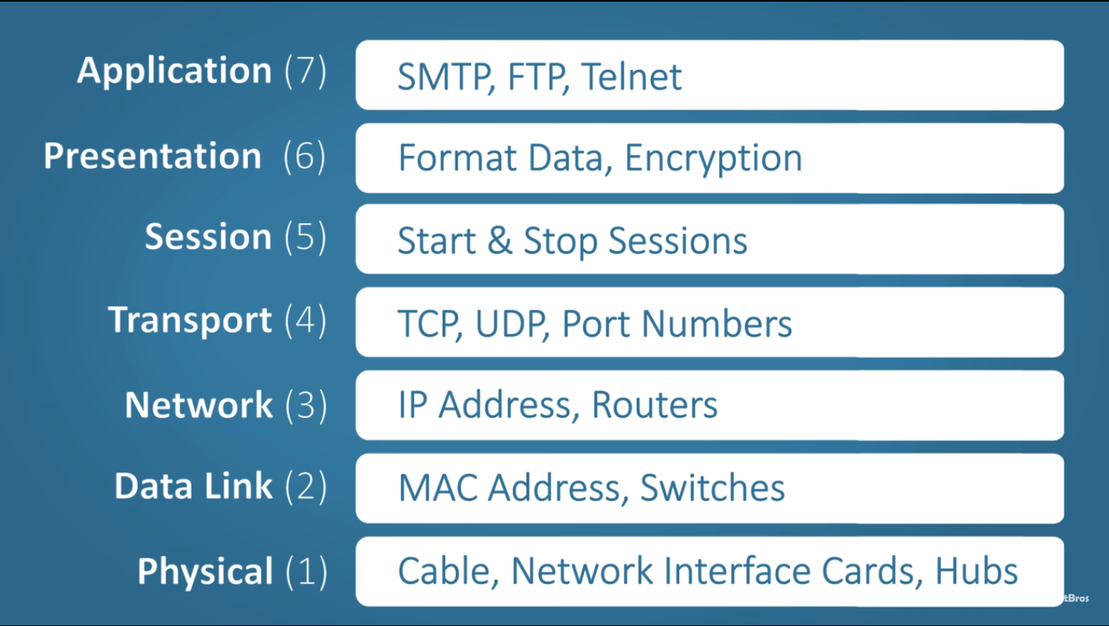

Slide 26
Why need “layers”
Networks are complex,
with many “pieces”:
  hosts
  routers
  links of various media
  applications
  protocols
  hardware, software

Slide 27
Organization of air travel
ticket (purchase)
baggage (check)
gates (load)
runway takeoff
airplane routing
ticket (complain)
baggage (claim)
gates (unload)
runway landing
airplane routing
airplane routing
a series of steps

Slide 28

Layering of airline functionality
ticket (purchase)
baggage (check)
gates (load)
runway (takeoff)
airplane routing
ticket (complain)
baggage (claim
gates (unload)
runway (land)
airplane routing
ticket
baggage
gate
takeoff/landing
airplane routing
airplane routing
airplane routing
departure
airport
intermediate air-traffic
control centers
arrival
airport
layers: each layer implements a service
  via its own internal-layer actions
  relying on services provided by layer below

Slide 29
Why layering?
dealing with complex systems:
allows identification, relationship of complex system’s pieces
  layered reference model for discussion
Layers eases maintenance, updating of system
  change of implementation of layer’s service transparent to rest of system
  e.g., change in port procedure doesn’t affect rest of system
layering considered harmful?

Slide 30
Internet protocol stack
application: supporting network applications
  FTP, SMTP, HTTP
transport: process-process data transfer
  TCP, UDP
network: routing of datagrams from source to destination
  IP, routing protocols
link: data transfer between neighboring network elements
  Ethernet, 802.111 (WiFi), PPP (Point-to-Point Protocol)
physical: bits “on the wire”
application
transport
network
link
physical

Slide 31
ISO/OSI reference model
presentation: allow applications to interpret meaning of data, e.g., encryption, compression, session: synchronization, checkpointing, recovery of data exchange
Internet stack “missing” these layers!
  these services, if needed, must be implemented in application
  needed?
application
presentation
session
transport
network
link
physical

Slide 32
Encapsulation
source
message
M
application
transport
network
link
physical
segment
H_{t}
M
H_{t}
datagram
H_{n}
H_{n}
H_{t}
M
frame
H_{l}
H_{n}
H_{t}
M
link
physical
switch
destination
H_{n}
H_{t}
M
network
link
physical
M
application
transport
network
link
physical
H_{l}
H_{n}
H_{t}
M
H_{n}
H_{t}
M
H_{t}
M
H_{n}
H_{t}
M
H_{l}
H_{n}
H_{t}
M
router

